Slide 1


Introduction to Activation Functions
By :- Data Science Wallah

Slide 2

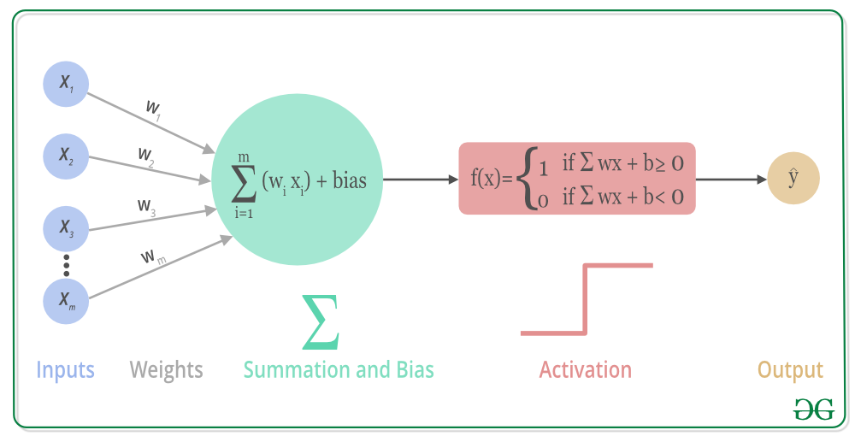
What is an Activation Function?
An activation function is like a gatekeeper for each neuron in a neural network. It decides whether the neuron should "fire" or not, which means passing information to the next layer.
Without activation functions, a neural network would just be a complicated math equation with no ability to learn complex patterns.
Imagine you’re trying to predict the price of a house. The network learns simple rules (like bigger houses cost more) using linear equations. But to understand more complex rules (like houses near schools cost even more), the network needs to be able to make non-linear decisions. That’s where activation functions come in.

Slide 3
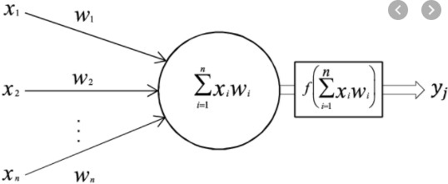
Activation Functions
i₁
Activation Function is applied over the linear weighted summation of the incoming information to a node.
Convert linear input signals from perceptron to
a linear/non-linear output signal.
It decides whether to activate a node or not.
i₂
h₁
i₃
Activation Function

Slide 4
Why Do We Need Activation Functions?
Imagine a Simple Task: Think of a basic calculator. If you input 2 + 2, it will always give you 4. This is a straightforward linear operation. But what if you want the calculator to predict something complex, like whether an image is of a cat or a dog? A simple calculator can't do that because it's limited to just adding and multiplying numbers.
Role of Activation Functions: Activation functions are like magical switches in a neural network. They allow the network to take complex decisions, beyond just adding or multiplying. Instead of just giving you linear, straightforward results like a basic calculator, these functions help the network understand and predict much more complicated things, like identifying a cat in a picture or recognizing handwritten digits.
Example in Simple Terms: Think of a light switch (a neuron) that only turns on when it gets a signal (input). The activation function is like a smart switch. It decides not just "on" or "off," but maybe "dim," "bright," or "super bright" depending on the situation. For instance, with an activation function, the network might see an ear and a tail in a picture and think, "This is bright enough to say it's a cat."

Slide 5
Types of Activation Functions
1. Linear Activation Function
Explanation: This is the simplest type of activation function. It just outputs the input as it is but with a weight (a number) multiplied by it.
Example: Imagine a volume control. If you turn the knob, the output sound is just the input sound, but louder or softer depending on how much you turned it.
2. Non-Linear Activation Functions
These are more commonly used in neural networks because they allow the model to learn complex patterns. Without them, the network would behave like a plain straight line and wouldn’t be able to handle complex data.

Slide 6
Activation Functions
i₁
i₂
h₁
Activation functions must be monotonic, differentiable, and quickly converging.
i₃
Types of Activation Functions:
Linear
Non-Linear
Activation Function

Slide 7
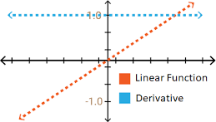
Linear
𝑓𝑥 = 𝑎𝑥 + 𝑏
𝑑𝑓(𝑥)
= 𝑎
𝑑𝑥
Observations:
Constant gradient (In a linear activation function, the gradient (slope) is constant. the linear function's gradient is a fixed value (often 1). This means the rate of change of the output is constant, regardless of the input.)
Gradient does not depend on the change in the input (Since the gradient is constant, it does not depend on the value of the input. Whether the input increases or decreases, the gradient remains unchanged. This characteristic prevents the model from capturing complex patterns, as it only produces a straight line output.)

Slide 8
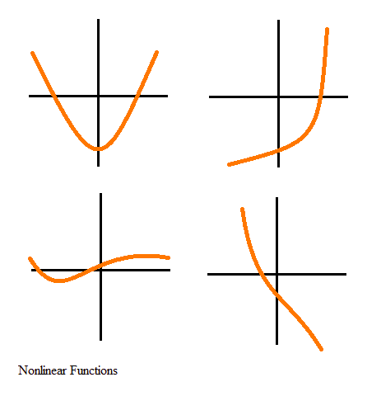
Non-Linear
Sigmoid (Logistic)
Softmax
Hyperbolic Tangent (Tanh)
Rectified Linear Unit (ReLU)
Leaky Relu
Parametric Relu
Exponential Linear Unit (ELU)

Slide 9
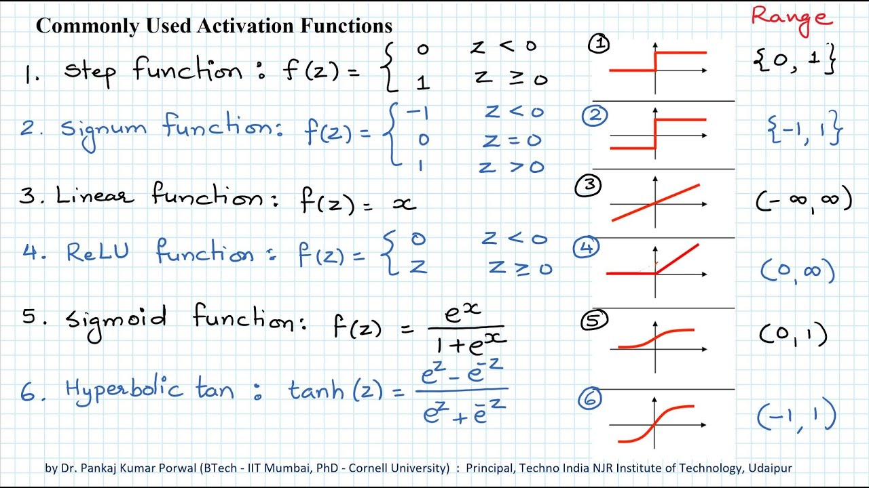

Slide 10
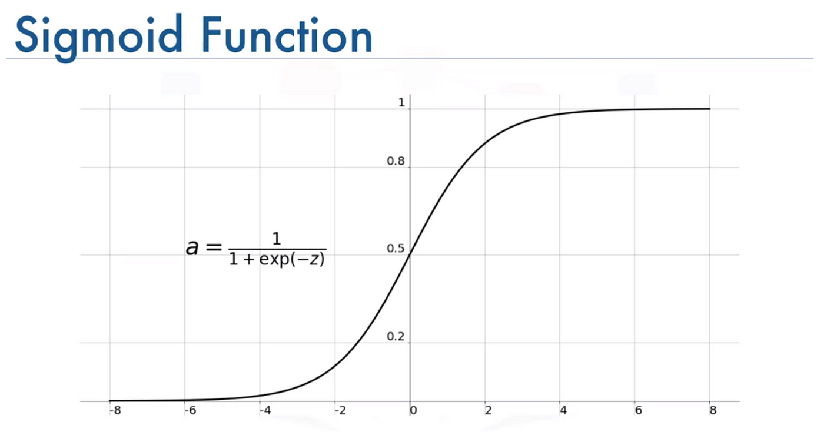
Sigmoid Function
Explanation: This function squashes the input value into a range between 0 and 1. It’s like squeezing all your test scores into a range where 0 is the lowest and 1 is the highest.
Real-Life Example: Used in medical diagnosis systems where we classify whether a patient has a disease (1) or not (0).

Slide 11
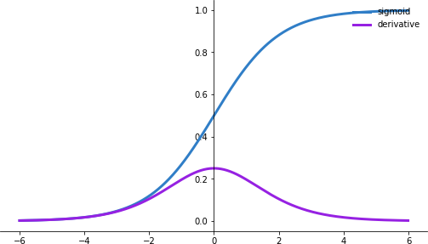
Sigmoid Activation Functions (Logistics)
1
=
1 + 𝑒^{−𝑥}
𝑓𝑥
𝑑𝑓(𝑥)
= 𝑓𝑥 (1 − 𝑓(𝑥))
𝑑𝑥
Output: 0 to 1(This makes it useful when you need probabilities or binary classification outputs.)
Outputs are not zero-centered (The output of the Sigmoid function is always positive, which means it is not zero-centered. This can cause issues during training because gradients might push weights in one direction only, slowing convergence.)
Can saturate and kill (vanish) gradients (When the input is very high or very low, the gradient of the Sigmoid function becomes nearly zero. This can cause the gradient to vanish, effectively "killing" it. In deep networks, this results in very slow learning or no learning at all in those layers.)

Slide 12
Softmax Activation Function:
Explanation: Converts outputs into probabilities that sum to 1. It’s ideal for multi-class classification problems.
Real-Life Example: Used in email classification to sort emails into categories like ‘Inbox,’ ‘Spam,’ ‘Promotions,’ etc.

Slide 13
Tanh (Hyperbolic Tangent) Function:
Explanation: The Tanh function is similar to sigmoid but outputs values between -1 and 1, making it more useful when data is centered around .
​Real-Life Example: Used in chatbot systems to generate outputs that can be either positive or negative, like customer satisfaction scores.

Slide 14
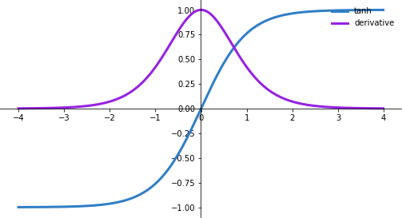
Tanh Activation Function
_{𝑒}𝑥 _{− 𝑒}−𝑥
=
_{𝑒}𝑥 _{+ 𝑒}−𝑥
𝑓𝑥
𝑑𝑓(𝑥)
= 1 − 𝑓(𝑥)²
𝑑𝑥
Observations:
Output: -1 to +1 (This allows for both negative and positive outputs, making it useful when the data or model requires zero-centered outputs.)
Outputs are zero-centered (Unlike the Sigmoid function, Tanh outputs are zero-centered. This means that the average output is closer to zero, which helps the gradients in the network flow better, leading to faster convergence during training. )
Can Saturate and kill (vanish) gradients (Similar to the Sigmoid function, when the input values are very high or very low, the Tanh function’s gradient becomes almost zero)
Gradient is more steeped than Sigmoid, resulting in faster convergence (The gradient of the Tanh function is steeper than that of the Sigmoid function, especially around the center. This means that the model learns faster because the updates are more significant.)

Slide 15
ReLU (Rectified Linear Unit) Activation Function:
Explanation: ReLU only passes positive values, turning negative values into 0. It’s simple and helps the model to learn faster.
Real-Life Example: Used in image recognition systems to identify objects because it handles high-dimensional data well.

Slide 16
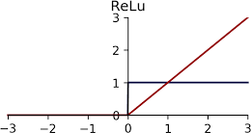
Rectified Linear Unit(ReLU)
𝑓𝑥 = max(0, 𝑥)
𝑑𝑓(𝑥)
= 1
𝑑𝑥
Observations:
Greatly increase training speed compared to tanh and sigmoid (ReLU only activates when the input is positive, leading to faster and more efficient training as it avoids complex calculations, unlike Tanh and Sigmoid.)
Reduces likelihood of killing(vanishing) gradient (Since ReLU doesn’t saturate in the positive range, the gradients don’t vanish as easily, allowing the model to learn deeper layers more effectively.)
It can blow up activation (ReLU can produce very large outputs, leading to instability if not properly managed. This can cause the model to diverge during training.)
Dead nodes (If the input to a ReLU is negative, it outputs zero. Over time, some neurons may stop activating (output zero) entirely, leading to "dead" neurons that no longer contribute to learning.)

Slide 17
Leaky ReLU Activation Function:
Explanation: Similar to ReLU, but allows a small gradient for negative values instead of turning them into 0, helping to solve the “dying ReLU” problem.
Real-Life Example: Used in financial forecasting models where both losses and gains need to be predicted.

Slide 18
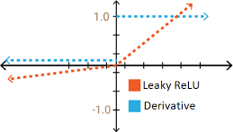
Leaky-ReLU
𝑓𝑥 = max(0.01𝑥, 𝑥)
𝑑𝑓(𝑥)
_{= ቊ}0.01,
𝑥 < 0
𝑥 ≥ 0
𝑑𝑥
1,
Observations:
Fixed dying ReLU (The Leaky ReLU activation function addresses the "dying ReLU" problem, where neurons can get stuck and stop learning when their ReLU output is zero for all inputs. This happens because the gradient becomes zero, preventing updates to the neuron. Leaky ReLU fixes this by allowing a small, non-zero gradient for negative input values, ensuring that neurons continue to learn.)

Slide 19
Data Science Wallah

